Slide 1
Network Layer:
Routing

Slide 2
The Internet network layer
host, router network layer functions:
transport layer: TCP, UDP
routing protocols
path selection
RIP, OSPF, BGP
IP protocol
addressing conventions
datagram format
packet handling conventions
network
layer
forwarding
table
ICMP protocol
error reporting
router “signaling”
link layer
physical layer

Slide 3
Routing protocols
Routing protocol goal: determine “good” paths (equivalently, routes), from sending hosts to receiving host, through network of routers
path: sequence of routers packets will traverse in going from given initial source host to given final destination host
“good”: least “cost”, “fastest”, “least congested”
routing: a “top-10” networking challenge!

Slide 4
Graph abstraction of the network
5
v
3
w
2
5
u
2
1
z
3
1
2
x
y
1
graph: G = (N,E)
N = set of routers = { u, v, w, x, y, z }
E = set of links ={ (u,v), (u,x), (v,x), (v,w), (x,w), (x,y), (w,y), (w,z), (y,z) }
aside: graph abstraction is useful in other network contexts, e.g.,
P2P, where N is set of peers and E is set of TCP connections

Slide 5
Graph abstraction: costs
5
c(x,x’) = cost of link (x,x’)
e.g., c(w,z) = 5
cost could always be 1, or
inversely related to bandwidth,
or inversely related to
congestion
v
3
w
2
5
u
2
1
z
3
1
2
x
y
1
cost of path (x₁, x₂, x₃,…, x_{p}) = c(x₁,x₂) + c(x₂,x₃) + … + c(x_{p-1},x_{p})
key question: what is the least-cost path between u and z ?
routing algorithm: algorithm that finds that least cost path

Slide 6
Routing algorithm classification
Q: global or decentralized information?
global:
all routers have complete topology, link cost info
“link state” algorithms
decentralized:
router knows physically-connected neighbors, link costs to neighbors
iterative process of computation, exchange of info with neighbors
“distance vector” algorithms
Q: static or dynamic?
static:
routes change slowly over time
Manual configuration
dynamic:
routes change more quickly
  Automatic configuration
  periodic update
  in response to link cost changes

Slide 7
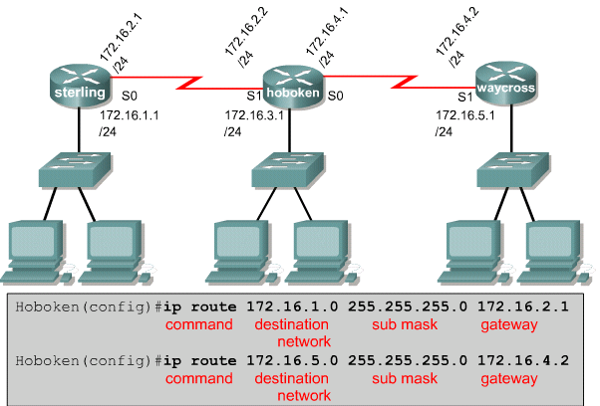
Static Routing
If static routing is used, the administrator configures the router manually
Next hop interface
Administrative distance of 1 - default

Slide 8
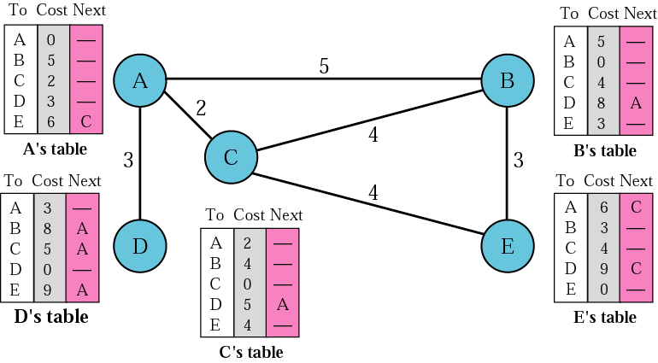
Distance Vector Routing
In distance vector routing, the least cost route between any two nodes is the route with minimum distance. In this protocol each node maintains a vector (table) of minimum distances to every node

Slide 9
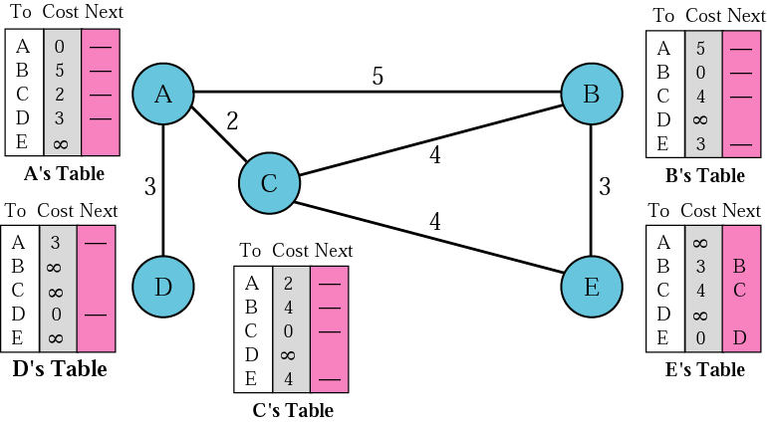
Distance Vector Routing: Initialization
In distance vector routing, each node shares its table with its immediate neighbor periodically (eg every 30s) and when there is a change.

Slide 10
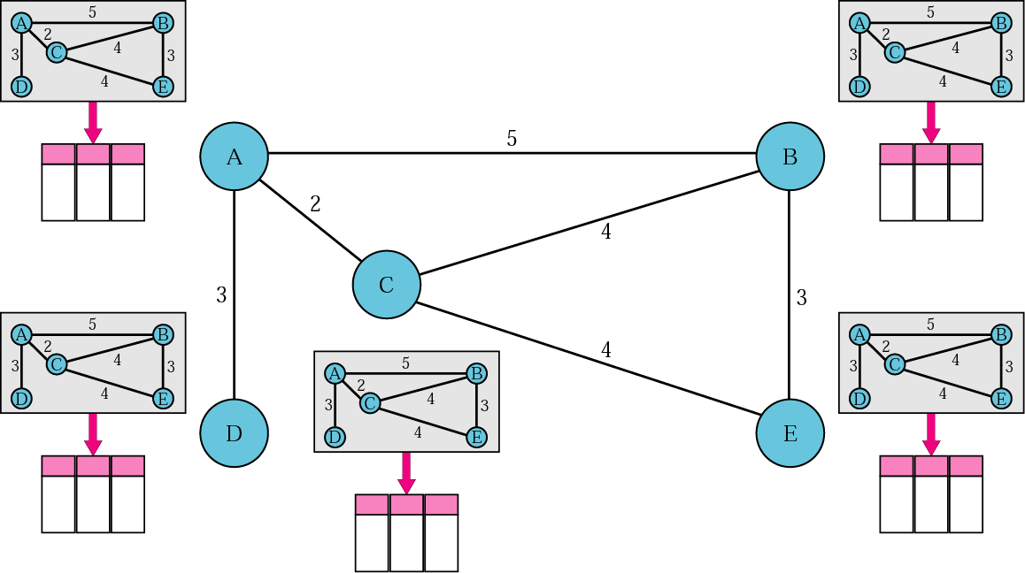
Link State Routing
In link state routing, if each node in the domain has the entire topology of the domain, the node can use Dijkstra’s algorithm to build a routing table.
Every router has knowledge about the network.

Slide 11
A link-state routing algorithm
Dijkstra’s algorithm
net topology, link costs known to all nodes
  accomplished via “link state broadcast”
  all nodes have same info
computes least cost paths from one node (‘source”) to all other nodes
  gives forwarding table for that node
iterative: after k iterations, know least cost path to k dest.’s
notation:
c(x,y): link cost from node x to y; = ∞ if not direct neighbors
D(v): current value of cost of path from source to dest. v
p(v): predecessor node along path from source to v
N': set of nodes whose least cost path definitively known

Slide 12
Dijsktra’s algorithm
1 Initialization:
2 N' = {u}
3 for all nodes v
4 if v adjacent to u
5 then D(v) = c(u,v)
6 else D(v) = ∞
7
8 Loop
9 find w not in N' such that D(w) is a minimum
10 add w to N'
11 update D(v) for all v adjacent to w and not in N' :
12 D(v) = min( D(v), D(w) + c(w,v) )
13 /* new cost to v is either old cost to v or known
14 shortest path cost to w plus cost from w to v */
15 until all nodes in N'

Slide 13
Dijkstra’s algorithm: example
D(v)
p(v)
D(w)
p(w)
D(x)
p(x)
D(y)
p(y)
D(z)
p(z)
Step
N'
0
u
7,u
3,u
5,u
∞
∞
1
uw
6,w
5,u
11,w
∞
2
uwx
6,w
11,w
14,x
3
uwxv
10,v
14,x
4
uwxvy
12,y
5
uwxvyz
x
9
5
7
4
8
u
3
w
y
z
2
3
7
4
v

Slide 14
SCALING ROUTING

Slide 15
Making routing scalable
our routing study thus far - idealized
all routers identical
network “flat”
… not true in practice
scale: with billions of destinations:
can’t store all destinations in routing tables!
routing table exchange would swamp links!
administrative autonomy
internet = network of networks
each network admin may want to control routing in its own network

Slide 16
Internet Routing
Internet organized as a two level hierarchy
First level – autonomous systems (AS’s)
  AS – region of network under a single administrative domain
  Examples: Comcast, AT&T, Verizon, Sprint, etc.
AS’s use intra-domain routing protocols (also known as interior Gateway protocols (IGP)) internally
  Distance Vector- Routing Information Protocol (RIP)
  Link State- Open Shortest Path First (OSPF)
Connections between AS’s use inter-domain routing protocols (also known as exterior Gateway protocols (EGP))
  Border Gateway Routing (BGP)

Slide 17



AS Example
Autonomous systems have an identifying number, assigned by American Registry of Internet Numbers (ARIN) or a provider. This ID is a 16-bit number
4
AS 100
AS 300
Interior Routers
AS 200
BGP
Routers

Slide 18
Internet approach to scalable routing
aggregate routers into regions known as “autonomous systems” (AS) (a.k.a. “domains”)
intra-AS routing
routing among hosts, routers in same AS (“network”)
all routers in AS must run same intra-domain protocol
routers in different AS can run different intra-domain routing protocol
gateway router: at “edge” of its own AS, has link(s) to router(s) in other AS’es
inter-AS routing
routing among AS’es
gateways perform inter-domain routing (as well as intra-domain routing)

Slide 19
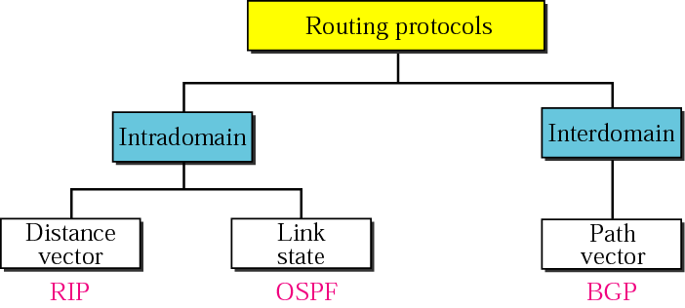
Popular Routing Protocols
Routing Information Protocol (RIP) is the implementation of the distance vector protocol
Open Shortest Path First (OSPF) is the implementation of the link state protocol
Border Gateway Protocol (BGP) is the implementation of the path vector protocol

Slide 20
Routing Information Protocol (RIP)
The Routing Information Protocol (RIP) is an intradomain routing protocol used inside an autonomous system. It is a very simple protocol based on distance vector routing.

Slide 21
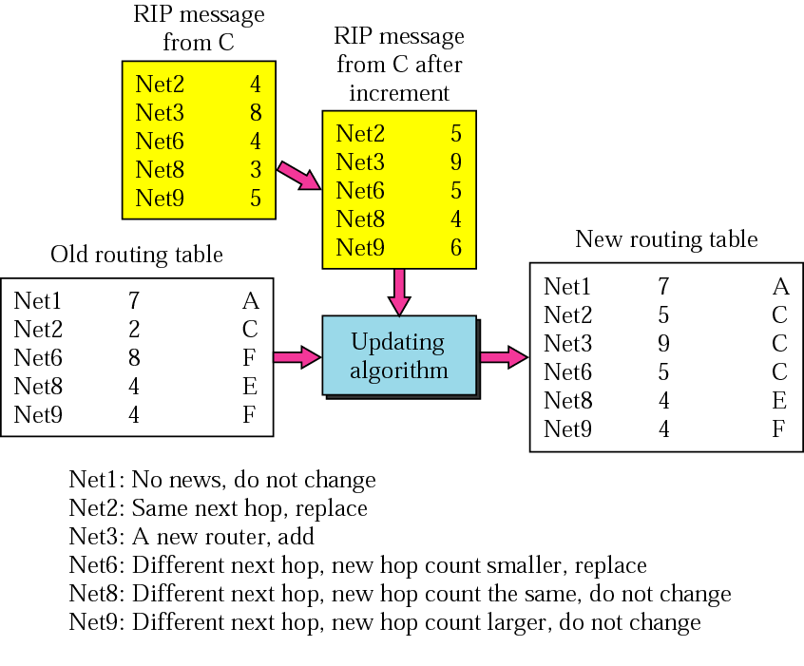
Routing Information Protocol
Receive a RIP message (a response)
Add one hop for each advertised dest
Repeat
  If (dest not in routing table)
    Add the advertised info to the table
  Else
    If (next-hop is the same)
      Replace with the advertised one
    Else
      If (advertised hop count < one in the table)
      Replace entry in the routing table
Return
Distance vector algorithm (Bellman-Ford)
  Sharing knowledge about the entire AS
  Shares only with neighbors
  Shares at regular intervals (different from DVA)

Slide 22
When to Share
The table is sent both periodically and when there is a change in the table
Periodic Update. A node sends its routing table, normally every 30 seconds, in a periodic update. The period depends on the protocol that is using distance vector routing
Triggered Update. A node sends its 2-column routing table to its neighbors any time there is a change in its routing table. This is called a triggered update. The change can result from the following.
  A node receive a table from a neighbor resulting in changes in its own table after updating
  A node detects some failure in the neighboring links which results in a distance change to infinity

Slide 23
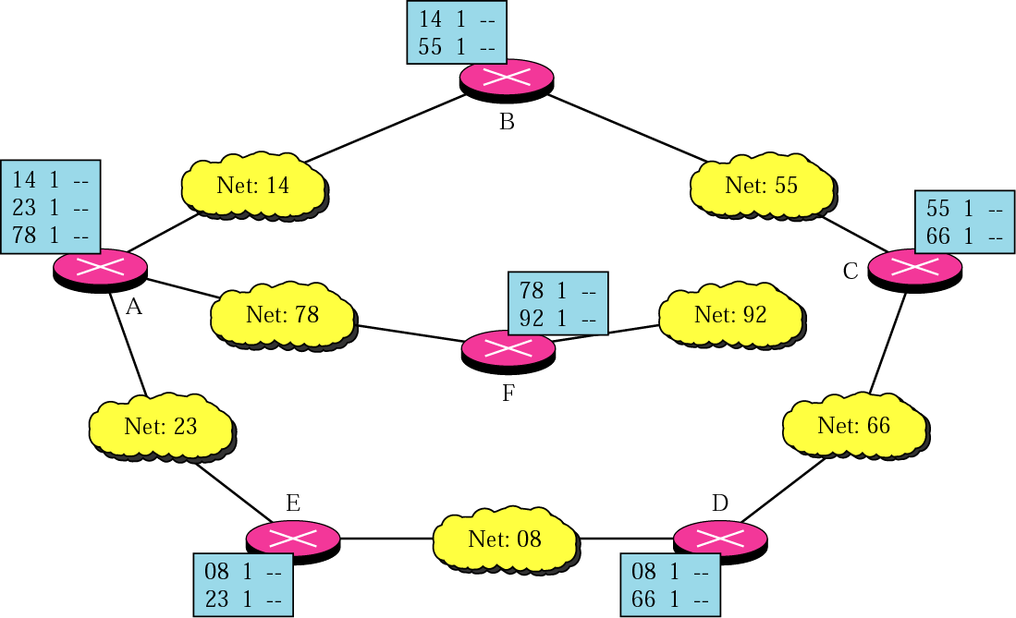
Initial routing tables in a small
autonomous system

Slide 24
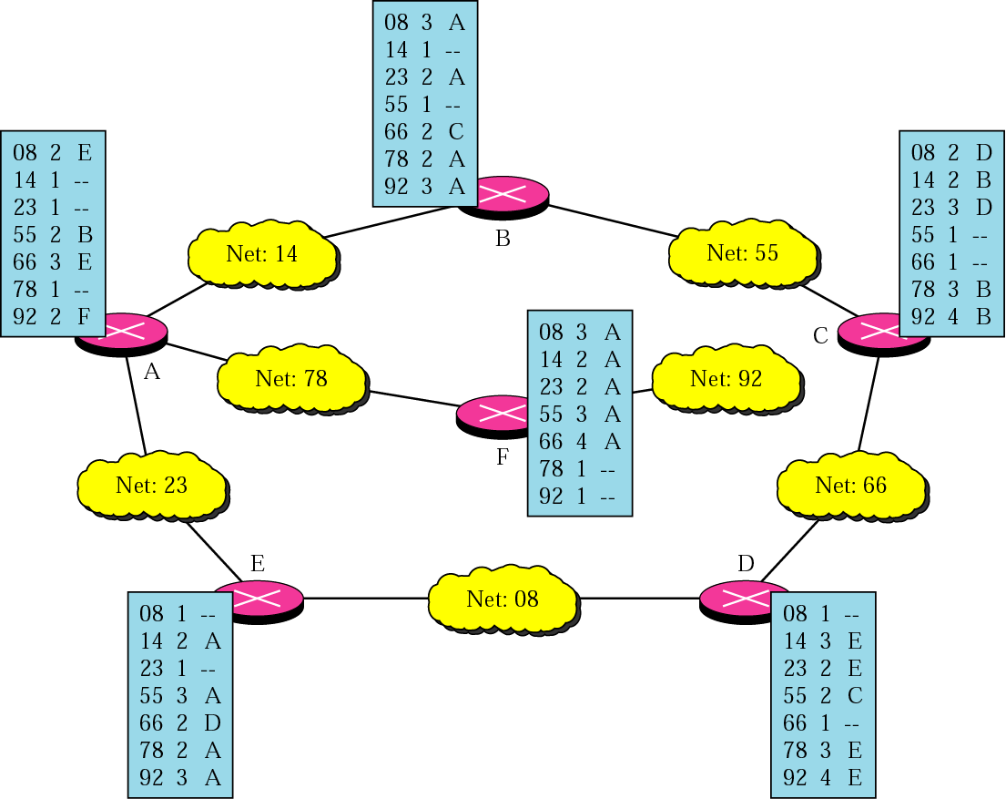
Final routing tables for the previous figure

Slide 25
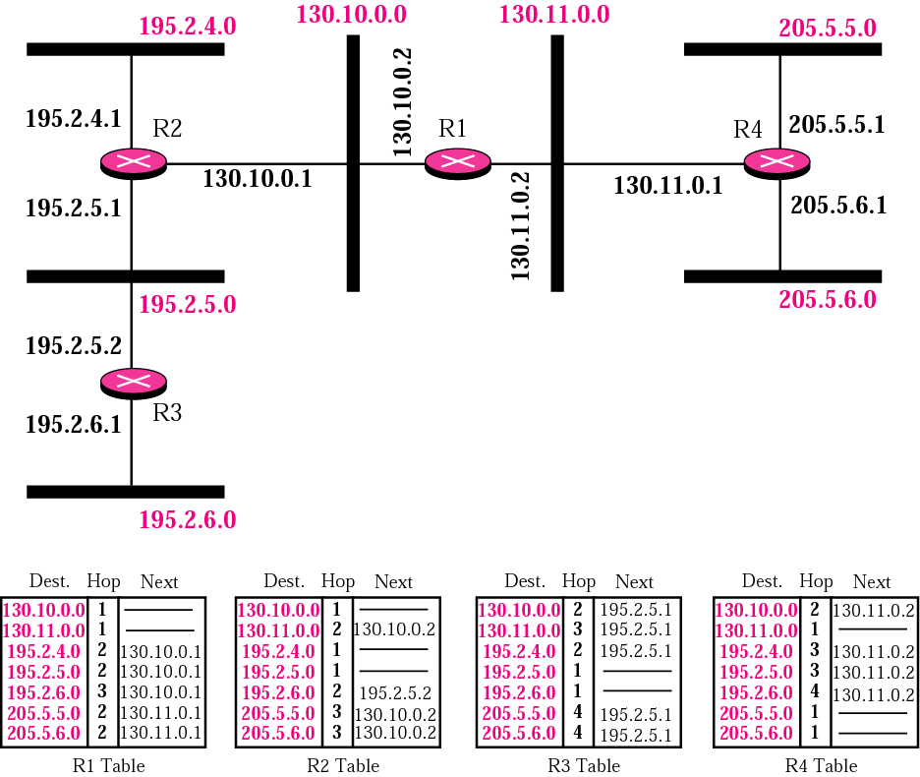
Example of a domain using RIP
Note the
metric used
here for Cost
is simply the
hop count.

Slide 26
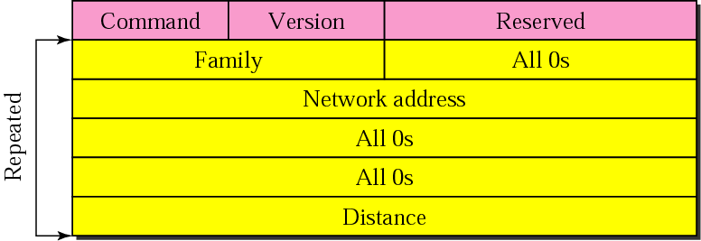
RIP Packet Format: Version 1
Command: request (1) or response (2)
Version: 1 or 2
Family: TCP/IP has value 2
Network address: address of the destination network
Distance: hop count from the advertising router to the destination network

Slide 27
Example
In next Figure shows the update message sent from router R1 to router R2 in previous Figure. The message is sent out of interface 130.10.0.2.
The message is prepared with the combination of split horizon and poison reverse strategy in mind. Router R1 has obtained information about networks 195.2.4.0, 195.2.5.0, and 195.2.6.0 from router R2. When R1 sends an update message to R2, it replaces the actual value of the hop counts for these three networks with 16 (infinity) to prevent any confusion for R2. The figure also shows the table extracted from the message. Router R2 uses the source address of the IP datagram carrying the RIP message from R1 (130.10.02) as the next hop address.

Slide 28
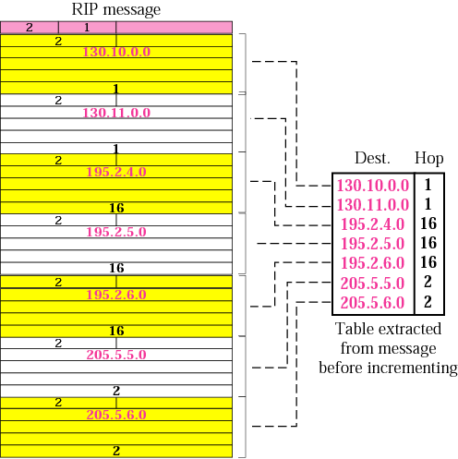
Solution Example
Hop=16 means dest. Is unreachable (only works on smaller networks)

Slide 29
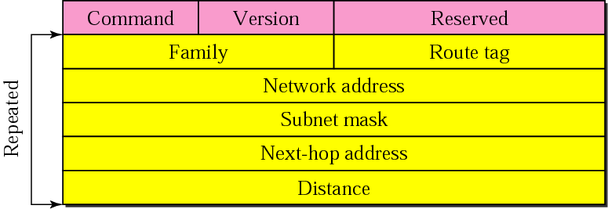
RIP Packet Format: Version 2

Slide 30
OSPF (Open Shortest Path First)
“open”: publicly available
uses link-state algorithm
  link state packet dissemination
  topology map at each node
  route computation using Dijkstra’s algorithm
router floods OSPF link-state advertisements to all other routers in entire AS
  carried in OSPF messages directly over IP (rather than TCP or UDP)
  link state: for each attached link
IS-IS routing protocol: nearly identical to OSPF

Slide 31
OSPF “advanced” features
security: all OSPF messages authenticated (to prevent malicious intrusion)
multiple same-cost paths allowed (only one path in RIP)
for each link, multiple cost metrics for different TOS (e.g., satellite link cost set low for best effort ToS; high for real-time ToS)
integrated uni- and multi-cast support:
  Multicast OSPF (MOSPF) uses same topology data base as OSPF
hierarchical OSPF in large domains.

Slide 32
Hierarchical OSPF
boundary router
backbone router
backbone
area
border
routers
area 3
internal
routers
area 1
area 2

Slide 33
Hierarchical OSPF
two-level hierarchy: local area, backbone.
  link-state advertisements only in area
  each nodes has detailed area topology; only know direction (shortest path) to nets in other areas.
area border routers: “summarize” distances to nets in own area, advertise to other Area Border routers.
backbone routers: run OSPF routing limited to backbone.
boundary routers: connect to other AS’es.

Slide 34
Internet inter-AS routing: BGP
BGP (Border Gateway Protocol): the de facto inter-domain routing protocol
  “glue that holds the Internet together”
BGP provides each AS a means to:
  eBGP: obtain subnet reachability information from neighboring ASes
  iBGP: propagate reachability information to all AS-internal routers.
  determine “good” routes to other networks based on reachability information and policy
allows subnet to advertise its existence to rest of Internet: “I am here”

Slide 35
eBGP, iBGP connections
2b
∂
2a
2c
1b
3b
2d
∂
1a
1c
3a
3c
AS 2
1d
3d
AS 1
eBGP connectivity
AS 3
iBGP connectivity
1c
gateway routers run both eBGP and iBGP protocols

Slide 36
BGP basics
BGP session: two BGP routers (“peers”) exchange BGP messages over semi-permanent TCP connection:
  advertising paths to different destination network prefixes (BGP is a “path vector” protocol)
when AS3 gateway router 3a advertises path AS3,X to AS2 gateway router 2c:
  AS3 promises to AS2 it will forward datagrams towards X
AS 3
3b
AS 1
1b
3a
3c
1a
1c
AS 2
2b
3d
X
1d
2a
2c
BGP advertisement:
AS3, X
2d

Slide 37
BGP path advertisement
AS3
3b
AS1
1b
3a
3c
1a
1c
AS2
2b
3d
X
1d
AS3,X
AS2,AS3,X
2a
2c
2d
AS2 router 2c receives path advertisement AS3,X (via eBGP) from AS3 router 3a
Based on AS2 policy, AS2 router 2c accepts path AS3,X, propagates (via iBGP) to all AS2 routers
Based on AS2 policy, AS2 router 2a advertises (via eBGP) path AS2, AS3, X to AS1 router 1c

Slide 38
BGP path advertisement
AS3
3b
AS1
1b
AS3,X
3a
3c
1a
1c
AS2
2b
3d
X
1d
AS3,X
AS2,AS3,X
2a
2c
2d
gateway router may learn about multiple paths to destination:
AS1 gateway router 1c learns path AS2,AS3,X from 2a
AS1 gateway router 1c learns path AS3,X from 3a
Based on policy, AS1 gateway router 1c chooses path AS3,X, and advertises path within AS1 via iBGP

Slide 39
BGP messages
BGP messages exchanged between peers over TCP connection
BGP messages:
  OPEN: opens TCP connection to remote BGP peer and authenticates sending BGP peer
  UPDATE: advertises new path (or withdraws old)
  KEEPALIVE: keeps connection alive in absence of UPDATES; also ACKs OPEN request
  NOTIFICATION: reports errors in previous msg; also used to close connection

Slide 40
BGP, OSPF, forwarding table entries
Q: how does router set forwarding table entry to distant prefix?
AS3
3b
AS1
1b
AS3,X
1
AS3,X
3a
3c
1a
2
1c
local link interfaces
at 1a, 1d
AS2
2b
3d
X
2
1d
1
AS3,X
AS2,AS3,X
2a
2c
physical link
2d
dest
interface
recall: 1a, 1b, 1c learn about dest X via iBGP from 1c: “path to X goes through 1c”
…
…
…
…
X
1
1d: OSPF intra-domain routing: to get to 1c, forward over outgoing local interface 1

Slide 41
BGP, OSPF, forwarding table entries
Q: how does router set forwarding table entry to distant prefix?
AS3
3b
AS1
1b
1
3a
3c
1a
2
1c
AS2
2b
3d
X
1d
2a
2c
2d
dest
interface
recall: 1a, 1b, 1c learn about dest X via iBGP from 1c: “path to X goes through 1c”
…
…
…
…
X
2
1d: OSPF intra-domain routing: to get to 1c, forward over outgoing local interface 1
1a: OSPF intra-domain routing: to get to 1c, forward over outgoing local interface 2

Slide 42
Why different Intra-, Inter-AS routing ?
policy:
inter-AS: admin wants control over how its traffic routed, who routes through its net.
intra-AS: single admin, so no policy decisions needed
scale:
hierarchical routing saves table size, reduced update traffic
performance:
intra-AS: can focus on performance
inter-AS: policy may dominate over performance

Slide 43
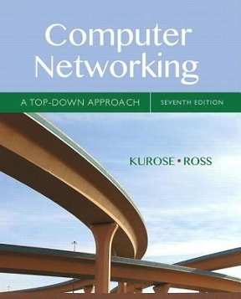

Further Reading
Kurose & Ross: Computer Networking: A Top-Down Approach, 7th Edition
Behrouz Forouzan: Data Communications and Networking, 4th Edition

